Slide 1
Lab 3: Op-Amp Integrator and Differentiator Circuits
EE316-08 Spring 2021

Slide 2
Purpose: The goal of this laboratory is to examine the circuit characteristics of the Op-Amp Integrator and Op-Amp Differentiator circuits.

Slide 3
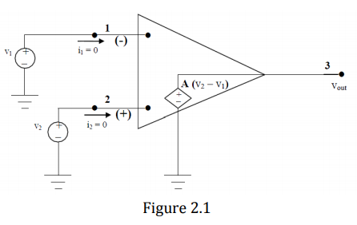

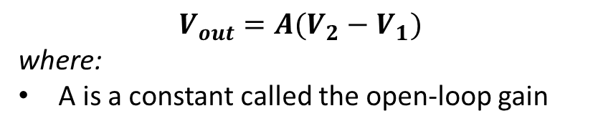
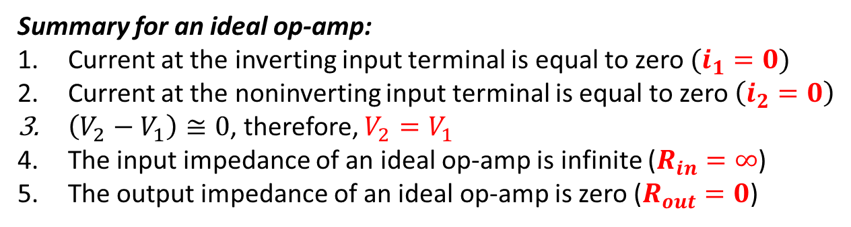




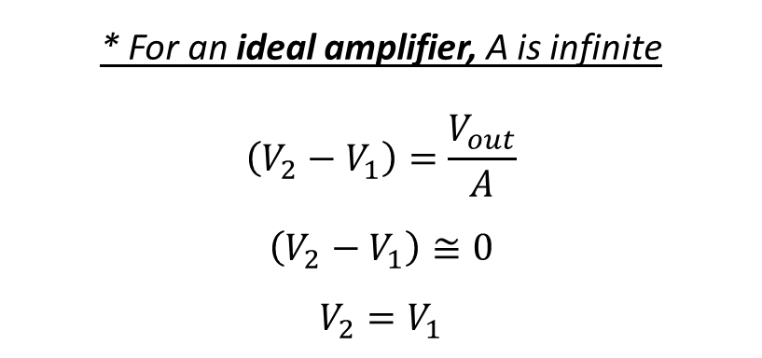

‘Ideal’ Operational Amplifier
The inverting input terminal
$$V_{out}=A(V_{2}−V_{1})$$
where:
A is a constant called the open-loop gain
$$V_{1}$$
$$R_{out}=0$$
* For an ideal amplifier, A is infinite
$$\left(V_{2}−V_{1}\right)=\frac{V_{out}}{A}$$
$$\left(V_{2}−V_{1}\right)≅0$$
$$V_{2}=V_{1}$$
$$i_{1}=0$$
$$R_{in}=∞$$
$$V_{2}$$
$$i_{2}=0$$
Summary for an ideal op-amp:
Current at the inverting input terminal is equal to zero $(i_{1}=0)$
Current at the noninverting input terminal is equal to zero$\left(i_{2}=0\right)$
$\left(V_{2}−V_{1}\right)≅0$, therefore, $V_{2}=V_{1}$
The input impedance of an ideal op-amp is infinite ($R_{in}=∞$)
The output impedance of an ideal op-amp is zero ($R_{out}=0$)
The noninverting input terminal

Slide 4
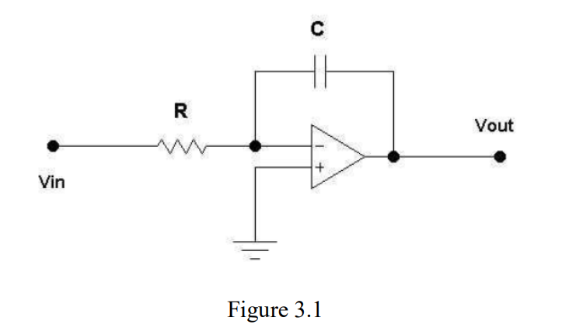
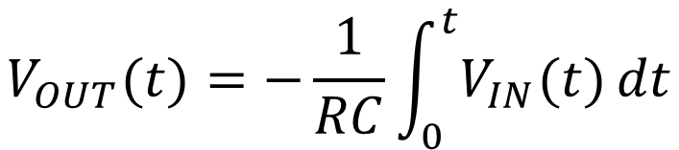
Integrator
The input signal is integrated at the output.
One problem of circuit in Fig. 3.1 is that the output tends to drift due to nonlinear characteristics of real op-amps such as voltage offset.
The integrator is useful for turning square waves into triangular waves, and triangular waves into sine waves.
The integrator’s output voltage is
$$V_{OUT}(t)=−\frac{1}{RC}\int_{0}^{t}{V_{IN}(t)}dt$$
Integrated input
Scale input

Slide 5
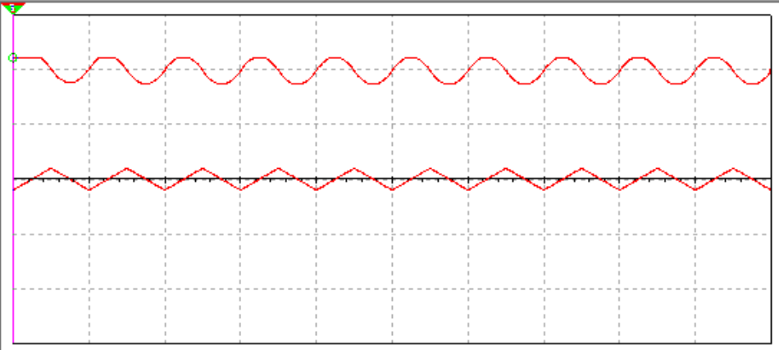
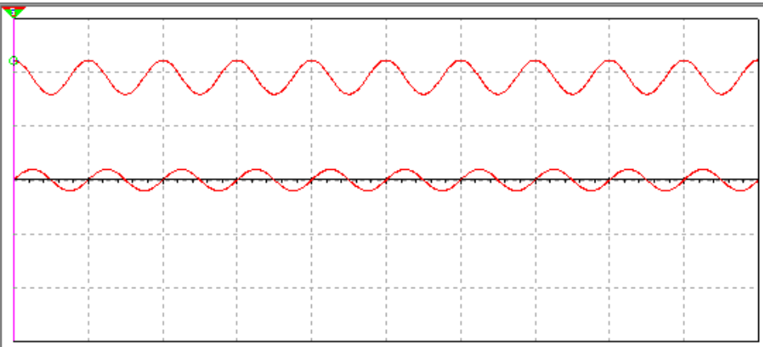
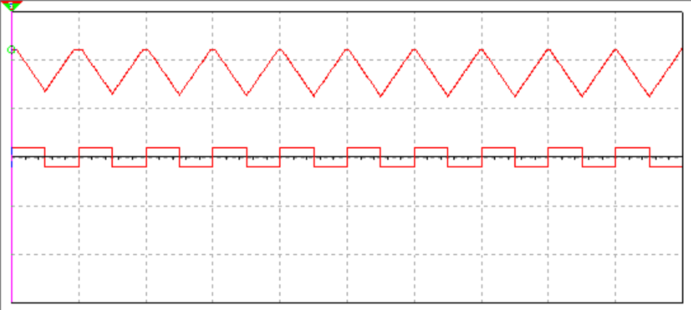
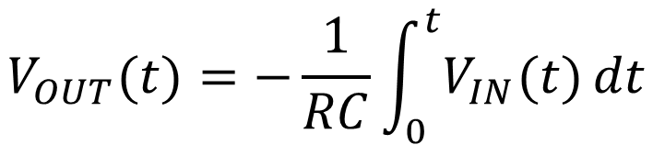
Integrator
Output Signal: Sine waves
$$V_{OUT}(t)=−\frac{1}{RC}\int_{0}^{t}{V_{IN}(t)}dt$$
Input Signal: Triangular waves
Output Signal: Cosine waves
Voltage Offset
Output Signal: Triangular waves
Input Signal: Sine waves
Input Signal: Square waves
NOTE: Results depend on your R, C and frequency values

Slide 6
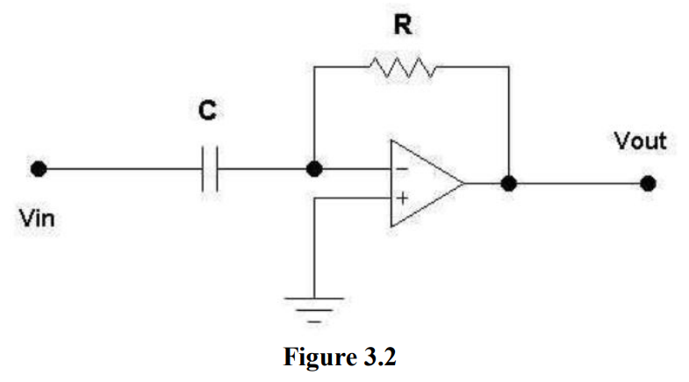
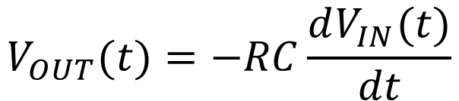
Differentiator
The differentiator does the opposite of the integrator.
The input signal is differentiated at the output.
Disadvantages of circuit in Fig. 3.2 are susceptible to noise and instability at high frequency.
The differentiator output voltage is
$$V_{OUT}(t)=−RC\frac{dV_{IN}(t)}{dt}$$
Scale
Take derivative of input

Slide 7
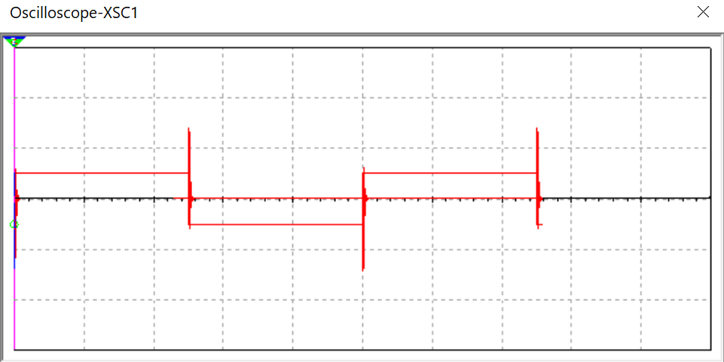
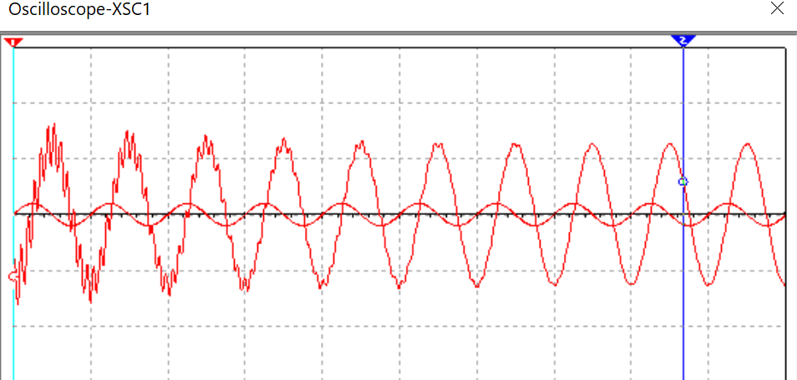
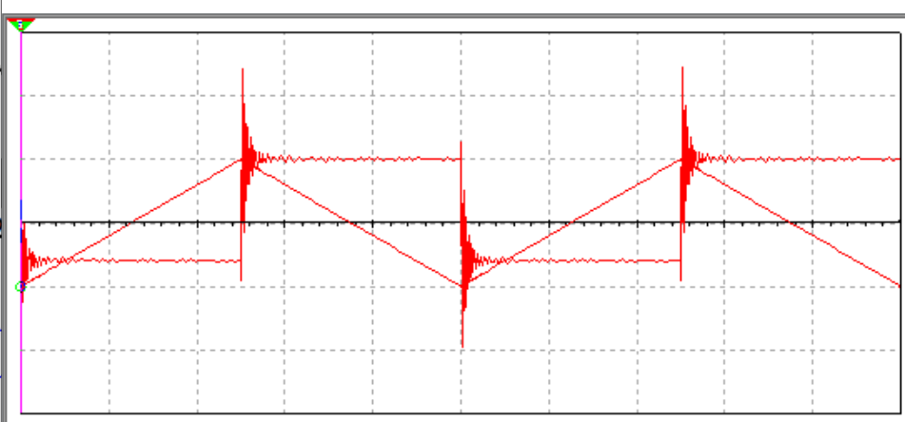
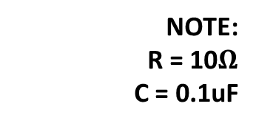
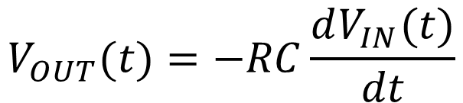
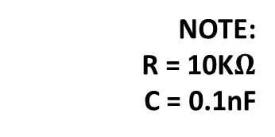
Differentiator
Input Signal: Square waves
$$V_{OUT}(t)=−RC\frac{dV_{IN}(t)}{dt}$$
NOTE:
R = 10K$Ω$
C = 0.1nF
Output Signal: Spike (approx. to dirac delta function)
Input Signal: Sine waves
Input Signal: Triangular waves
NOTE:
R = 10$Ω$
C = 0.1uF
Output Signal: Cosine waves
Output Signal: Square waves
Noisy
NOTE: Results depend on your R, C and frequency values

Slide 8
Summary
Lab 3 Report & Pre-lab 4 are due on Tuesday 9th February 2021 by midnight.
Analyze Fig. 3.1-3.2
Simulation
Calculations (Bonus Point)
Experimental section

